Slide 1
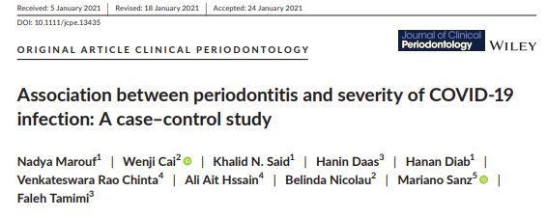
Guided by: Presented by:
Dr.P.Suresh, Dr.K.Latha,
PROF & HOD, PG STUDENT,
DEPARTMENT OF PERIODONTICS.

Slide 2
CONTENTS
INTRODUCTION
GENOME OF CoV.
REPLICATION CYCLE
DIAGNOSTIC CRITERIA
AIM
METHOD
STUDY DESIGN
SAMPLE SIZE CALCULATION & DATA ANALYSIS
RESULTS
DISCUSSION
CONCLUSION
REFERENCES

Slide 3
INTRODUCTION
In December 2019, a novel coronavirus (nCoV) termed “SARS-CoV2”, announced by the World Health Organization (WHO) as being responsible for the outbreak of COVID-19, was reported.
The incidence of the SARS-CoV (Severe Acute Respiratory Syndrome-coronavirus) in 2002 and 2003 and the MERS-CoV (Middle East Respiratory Syndrome-coronavirus) in 2012 showed the potential for the transmission of newly emerging CoVs from animal to human and person to person.

Slide 4
In total, seven human coronaviruses (HCoVs) have now been discovered, including HCoV229E, HCoV-OC43, HCoV-NL63, HKU1, SARS-CoV, MERS-CoV and SARS-CoV-2.
In the last two decades, SARS-CoV and MERS-CoV have caused epidemics with mortality rates of approximately 9.5% and 34.4%, respectively.
COVID-19 was the third highly epidemic disease to be detected, with a lower mortality rate than SARS and MERS, differing from country to country.

Slide 5
According to WHO statistics, there are 170,426,245(1 JUNE 2021) confirmed cases globally caused by the high transmission capacity of SARS-CoV-2.
The higher transmissibility, varied clinical manifestations and lower pathogenicity of COVID-19 could be a result of diversity in the biology and genome structure of the SARS-CoV-2 compared to SARS-CoV and MERS-CoV.

Slide 6
GENOMICS STRUCTURE AND BIOLOGICAL FEATURES OF SARS-COV-2
Coronaviruses belong to the order Nidovirales in the family coronaviridae.
Coronavirinae and Torovirinae subfamilies are divided from the family.
The subfamily Coronavirinae is further divided into four genera: Alpha-, Beta-, Gamma- and Delta- coronavirus.

Slide 7
Phylogenic analysis revealed that SARS-CoV-2 is closely related to the beta-coronaviruses. Similar to other coronaviruses, the genome of SARS-CoV-2 is positive-sense single-stranded RNA [(+) ssRNA] with a 5’ -cap, 3'-UTR poly(A) tail.
The length of the SARS-CoV-2 genome is less than 30 kb, in which there are 14 open reading frames (ORFs), encoding non-structural proteins (NSPs) for virus replication and assembly processes, structural proteins including spike (S), envelope (E), membrane/matrix (M) and nucleocapsid (N), and accessory proteins.

Slide 8
The first ORF contains approximately 65% of the viral genome and translates into either polyprotein pp1a (nsp1–11) or pp1ab (nsp1–16).
Among them, six nsps (NSP3, NSP9, NSP10, NSP12, NSP15 and NSP16) play critical roles in viral replication.
Other ORFs encode structural and accessory proteins.

Slide 9
The S protein is a transmembrane protein that facilitates the binding of viral envelop to angiotensin-converting enzyme 2 (ACE2) receptors expressed on host cell surfaces.
Functionally, the spike protein is composed of receptor binding (S1) and cell membrane fusion (S2) subunits. The N protein attaches to the viral genome and is involved in RNA replication, virion formation and immune evasion.

Slide 10
The nucleocapsid protein also interacts with the nsp3 and M proteins.
The M protein is one of the most abundant and well-conserved proteins in the virion structure.
This protein promotes the assembly and budding of viral particles through interaction with N and accessory proteins 3a and 7a.
The E protein is the smallest component in the SARS-CoV-2 structure that facilitates the production, maturation and release of virions.

Slide 11
The most complex component of the coronaviruses genome is the receptor-binding domain (RBD) in the spike protein.
Six RBD amino acids are necessary for attaching to the ACE2 receptor and hosting SARS-CoV-like coronaviruses.
According to multiple sequence alignment, they are Y442, L472, N479, D480, T487 and Y4911 in SARS-CoV, and L455, F486, Q493, S494, N501 and Y505 in SARSCoV-2.

Slide 12
Therefore, SARS-CoV-2 and SARS-CoV vary with respect to five of these six residues.
The SARS-CoV strain genome sequences derived from humans were very close to those in bats.
The ACE2 protein is found in many mammalian body tissues, primarily in the lungs, kidneys, gastrointestinal tract, heart, liver and blood vessels.

Slide 13
ACE2 receptors are vital elements in regulating the renin-angiotensin-aldosterone system pathway.
Based on structural experiments and biochemical studies, SARS-CoV-2 appears to have an RBD that strongly binds to ACE2 receptors of humans, cats, ferrets and other organisms with the homologous receptors.

Slide 14
The genome sequencing of SARS-CoV-2 in January 2020 was shown to be 96% identical to the bat coronavirus (BatCoV) RaTG13 genome and 80% identical to the SARS-CoV genome.
However, significant differences exist. For example, the protein 8a sequence in the SARS-CoV genome is absent in the 2019-nCoV, and the protein 8b sequence of SARS-CoV-2 is 37 amino acids longer than that in SARS-CoV.

Slide 15
RNA viruses have a higher mutational load as a result of shorter replication times.
Based on comparative genomic studies between SARSCoV-2 and SARS-like coronaviruses, there are 380 amino acid substitutions in the nsps genes and 27 mutations in genes encoding the spike protein S of SARS-CoV-2.

Slide 16
These variations might explain the different behavioral patterns of SARS-CoV-2 compared to SARS-CoVs.
For example, the primary N501 T mutation in the Spike protein of SARS-CoV-2 could have significantly increased its binding affinity to ACE2.

Slide 17
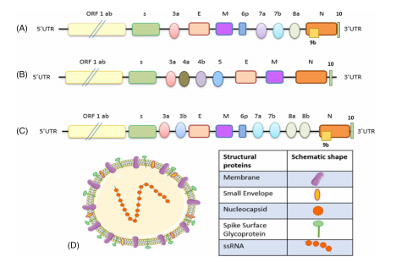

Slide 18
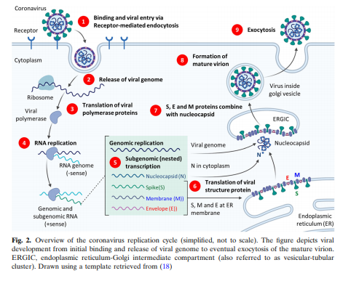

Slide 19
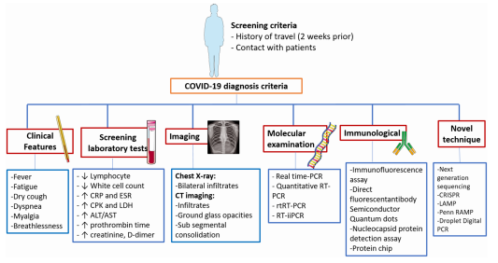

Slide 20
AIM
COVID-19 is associated with an exacerbated inflammatory response that can result in fatal outcomes. Systemic inflammation is also a main characteristic of periodontitis. Therefore, they investigated the association of periodontitis with COVID-19 complications.

Slide 21
METHODS:
STUDY POPULATION:
Patients diagnosed with COVID-19 were selected from the national electronic health records at of Hamad Medical Corporation (HMC) in the State of Qatar.
This corporation provides public health and dental coverage to the entire country and includes 14 hospitals holding approximately 85% of its hospital bed capacity.
HMC has a single electronic health record system (Cerner, Kansas City, USA), in which each patient retains a unique hospital identification number for both the medical and dental records.

Slide 22
Every patient with confirmed COVID-19 diagnosis according to the WHO interim guidelines (WHO, 2020a) and two subsequent positive PCR test for SARS-CoV-2 were included from 27 February 2020, the first date of a recorded COVID-19 diagnosis in Qatar, until 31 July 2020,
INCLUSION CRITERIA:
Adults (≥18 years old) discharged or deceased due to COVID-19 before the study end-date (31 August 2020), and with active dental records at Hamad Dental Services (HMC), with at least one dental appointment during the year preceding the Pandemic (March 2019 to March 2020).

Slide 23
EXCLUSION CRITERIA:
Patients with no dental radiographs in the records were excluded because the presence of periodontitis could not be objectively confirmed. Also, patients under the age of 18 were excluded because they are unlikely to develop neither COVID-19 complications nor periodontitis.

Slide 24
STUDY DESIGN
This case–control study of COVID-19 outcomes assessing periodontal status as exposure was approved by the Institutional Review Board of Hamad Medical Corporation with a waiver of informed consent under a pandemic response framework adopted by the institution.
Cases were defined as patients with registered COVID-19 complications in their records including death, ICU admissions or need of assisted ventilation due to COVID-19.

Slide 25
Controls were defined as COVID patients discharged without major complications.
No matching for controls was performed as all controls were included for analysis.
Our main exposure variable (periodontitis) and covariates (e.g. demographics, medical conditions), and outcomes of COVID-19 were extracted from the electronic health records at the Business Intelligence Center of Hamad Medical Corporation.

Slide 26
The periodontal status was studied from posterior bitewings and panoramic radiographs in the patient's electronic records, using the XELIS Dental 1.0, Dental 3D INFINITT PACS® software.
Interdental bone loss was measured in the posterior sextants using as reference the cement-enamel junction (CEJ) and the total length of the root.
The percentage of bone loss was obtained from the most affected tooth using the criteria from the recent classification of periodontal and peri-implant diseases (Jepsen et al., 2018).

Slide 27
When both bitewings and OPGs were available, the image with higher percentage of bone loss was selected.
Periodontitis was defined when bone loss was detected at two or more non-adjacent teeth, after excluding local factors related to periodontal-endodontic lesions, cracked and fractured roots, caries, restorative factors and impacted third molars.

Slide 28
In light of the low sensitivity of panoramic and/or bite wing radiographs for slight bone crestal changes (Hellen-Halme et al., 2020), patients were categorized as follows (Tonetti et al., 2018):
• Periodontally healthy or initial periodontitis (Stages 0–1): Bone loss less than the coronal third of the root length (15%) in OPGs, or ≤2 mm in bitewing radiographs.
• Periodontitis (Stages 2–4): Bone loss more than the coronal third of the root length (>15%) in OPGs, or >2 mm in bitewing radiographs.

Slide 29
Each radiograph was assessed by two blinded investigators (N.M., H.D.).
In case of discrepancy, a third blinded investigator (K.S.) reviewed the radiographs, and the majority diagnosis was considered.
Investigators (N.M. H.D., K.S. and M.S.) were calibrated before the study reaching a kappa index of 90%.

Slide 30
They also obtained information on demographic (sex and age) and other relevant risk factors associated with COVID-19 complications, such as body mass index (BMI, kg/m2 ), smoking habits, asthma, other chronic respiratory disease, chronic heart disease, diabetes, dermatitis, chronic liver disease, common autoimmune diseases (rheumatoid arthritis, systemic lupus erythematosus or psoriasis), solid organ transplant, peptic ulcer, immunosuppressive conditions, cancer, chronic kidney disease, hypertension, cerebrovascular accident, peptic ulcer and deep vein thrombosis.
These conditions were determined by the presence of at least one ICD-10 code related to the above conditions in the patients record prior to the onset of the pandemic.

Slide 31
BMI was categorized as overweight/obese (BMI ≥ 25) and adequate/underweight (BMI < 25), smoking was categorized as current/ past, and never smokers, and diabetes as present or absent.
For the other chronic conditions, are created a variable “comorbidity” by computing the presence of each of the above condition. The values of this variable ranged from 0 to 7; we further categorized the variable according to number of comorbidity into 0, 1, and ≥2 because of low numbers in some of the categories.

Slide 32
Blood parameters relevant to the course of the disease such as concentrations of D-Dimer, CRP, HbA1c, Vitamin D, white blood cells (WBC) and lymphocytes were also collected from the electronic records.
Both the initial parameters measured upon diagnosis as well as the latest parameters measured prior to discharge were collected.

Slide 33
Sample size calculation and data analysis
A priori sample size calculation for logistic regression was used to determine the target sample size.
For a minimum of four predictors, an expected R of 0.3, and a significance level set at α=0.05, a minimum sample size of n = 320 was determined to be needed to achieve an 80% power.
The association between periodontitis and COVID-19 severity was analysed using logistic regression and data were reported as odds ratios (OR) and 95% confidence intervals (CIs).

Slide 34
All models were adjusted for possible confounders including age, sex, smoking, BMI, diabetes and comorbidities.
While age was used as a continuous variable, the remaining variables were categorical or binary variables.
Additional sensitivity analyses were preformed by stratifying the data according to age groups, diabetes and smoking.
Laboratory values were assessed for normality and compared between groups using Mann and Whitney test.
Statistical analyses were done using SPSS, version 20.0.

Slide 35
RESULTS
From the 1076 patients identified with COVID-19 diagnosis and active dental records, 443 were excluded due to either lack of dental radiographs or relevant medical information.
Furthermore, 65 patients were excluded for being <18 yrs of age.
A total of 568 COVID-19-positive patients were included for the analysis.
Among these, 40 experienced COVID complications (cases) & 528 were discharged without any complications (controls).

Slide 36
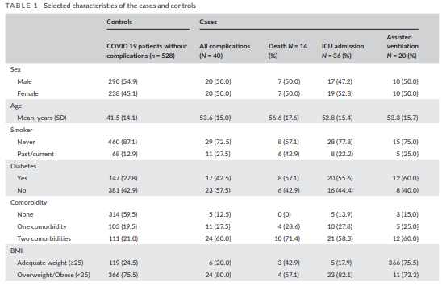

Slide 37
Table 1 displays the frequency distribution of the selected characteristics the study population.
There was an equal sex distribution among COVID 19 patients with and without complications.
As expected, patients with COVID-19 complications were older (mean 53.5 vs 41.5) and had more comorbidities than those without any complication.
Similarly, more than 80% of all patients who had COVID-19 complications had periodontitis compared to only 43% of those without COVID-19 complications.

Slide 38
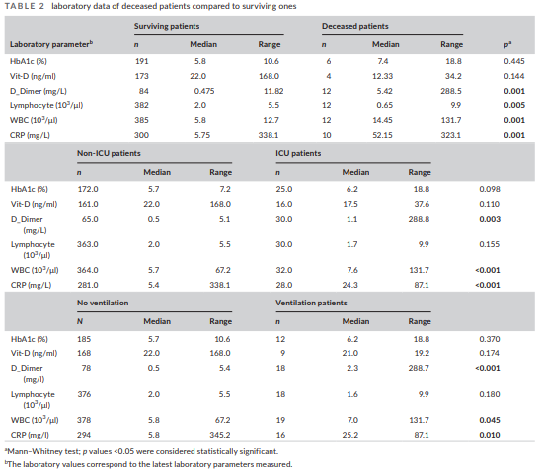

Slide 39
Table 2 reports the association between COVID-19 severity, and the laboratory biomarker data studied.
A total of 197 patients had laboratory records for HbA1c, 177 for Vit-D, 96 for D-Dimer, 394 for lymphocytes, 397 for WBC and 310 for CRP.
Assessment of the latest laboratory records revealed that the concentrations of D-dimer, WBC and CRP were significantly higher in COVID-19-deceased patients when compared with surviving patients.

Slide 40
On the other hand, the concentrations of lymphocytes were significantly lower in the deceased patients.
Patients admitted to the ICU as well as patients requiring assisted ventilation also had significantly higher D-dimer, WBC and CRP serum levels than patients that did not enter the ICU or those that did not require assisted ventilation, respectively.

Slide 41
Periodontal conditions of COVID-19 patients
Out of the 568 patients included in our study, a 258 presented periodontitis.
Among the patients who presented periodontitis, 33 experienced complications, while only 7 of the 310 patients without periodontitis presented COVID-19 complications Table 3 presents the unadjusted and adjusted OR and 95% confidence interval for the association between periodontitis and COVID-19 complications.

Slide 42
The risk of having COVID-19 complications among patients with periodontitis was OR 6.34 (95% CI 2.79–14.61) for any complications, OR 17.5 (95% CI 2.27–134.8) for death, OR 5.57 (95% CI 2.40– 12.9) for ICU admission and OR 7.31 (95% CI 2.21–26.3) for need for assisted ventilation.
After adjusting for possible confounders such as age, sex, smoking behavior and comorbidities, the multivariable analysis showed an adjusted OR of 3.67 (95% CI 1.46–9.27) for all COVID-19 complications, 8.81 (95% CI 1.00–77.7) for death, 3.54 (95% CI 1.39–9.05) for ICU admission and 4.57 (95% CI 1.19–17.4) for need of assisted ventilation.

Slide 43
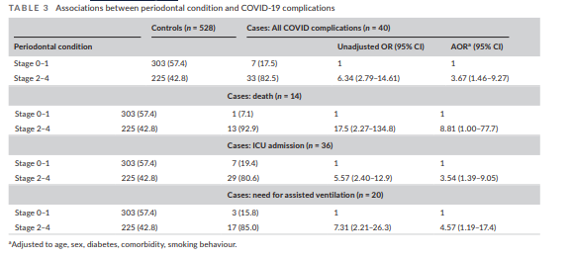

Slide 44
Because age, diabetes and smoking habits are stronger risk factors for both periodontitis and COVID-19 complications, they conducted subgroup analysis Upon stratifying by diabetes, smoking and age (Tables S1-S4), results remain similar.
Periodontitis was associated with increased risk of overall COVID-19 complications, death, ICU admission and need for ventilation.

Slide 45
After adjusting for potential confounders, periodontitis was significantly associated with overall COVID-19 as well as complications ICU admissions among diabetic patients, non-smokers and patients age 18–40 (Table S3).
In addition, periodontitis was also significantly associated with need for ventilation among non-smokers (Table S4).

Slide 46
Table 4 describes the association between periodontal status and the surrogate laboratory biomarkers studied. HbA1c, WBC and CRP blood levels were significantly higher in COVID-19 patients with periodontal disease than in those without periodontal disease

Slide 47
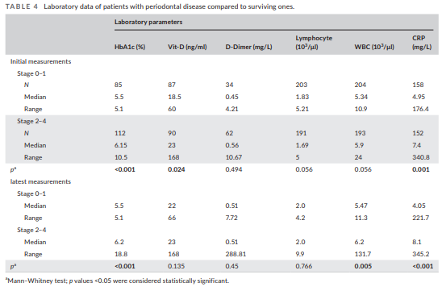

Slide 48
DISCUSSION
This study identified that the risk of COVID-19 complications was significantly higher among patients with moderate-to-severe periodontitis compared to those with milder or no periodontitis.
Periodontitis shares common risk factors with most chronic inflammatory diseases known to influence COVID-19 severity (Ruan et al., 2020; Zhou et al., 2020); thus, we performed multivariate logistic regression modeling to adjust this association for possible confounders such as age, sex, and smoking behavior, and for comorbidities (diabetes, hypertension, etc.).

Slide 49
After adjustment, periodontitis still had a significant impact on the course of COVID-19 infection, with significant associations COVID 19 complications (OR = 3.67, 95% CI 1.46–9.27), death (OR =8.81, 95% CI 1.00–77.7), ICU admission (OR = 3.54, 95% CI 1.39–9.05) and need for assisted ventilation (OR = 4.57, 95% CI 1.19–17.4).
These compelling results further confirm the association between periodontitis and worse progression of COVID-19.

Slide 50
Periodontitis has been shown to affect systemic health in multiple studies (Monsarrat et al., 2016) and has been independently associated with increased risk of most chronic NCDs (Genco & Sanz, 2020), in particular cardiovascular diseases (Tonetti & Van Dyke, 2013; LaMonte et al., 2017; Sanz et al., 2020); diabetes (Chapple et al., 2013; Suvan et al., 2015; Sanz et al., 2018); hypertension (Munoz Aguilera et al., 2020); chronic renal disease (Sharma et al., 2016), pneumonia (Gomes-Filho et al., 2020) and cancer (Nwizu et al., 2020).

Slide 51
Furthermore, a recent systematic review of 57 studies with 5.71 million participants reported the association of periodontitis with increased risk of mortality, specifically, in association with CVD, cancer, CHD and cerebrovascular diseases (Romandini et al., 2020). These associations have been explained, by shared genetic and environmental risk factors, and also through common chronic inflammatory pathways (Schenkein et al., 2020).

Slide 52
Several hypothetical mechanisms may explain the strong associations observed between periodontitis and COVID-19 severity.
Takahashi et al suggested that aspiration of periodontopathic bacteria might aggravate COVID-19 by inducing the expression of angiotensin converting enzyme 2, a receptor for SARS-CoV-2, and inflammatory cytokines in the lower respiratory tract (Takahashi et al., 2020).
Also, it was suggested that periodontopathic bacteria might enhance SARSCoV-2 virulence by cleaving its S glycoproteins (Madapusi Balaji et al., 2020; Takahashi et al., 2020) and that the oral cavity, and specially periodontal pockets could act as a viral reservoir (Badran et al., 2020; Bao et al., 2020; Botros et al., 2020; Herrera et al., 2020; Kheur et al., 2020).

Slide 53
Gupta et al indicated that Neutrophil Extracellular Trap production is involved in the pathogenesis of both diseases (Gupta & Sahni, 2020), and Sahni et al suggested that the strong Th17 response in severe periodontitis could exacerbate the cytokine storm in COVID-19 (Sahni & Gupta, 2020).
All these hypothetical pathways could also foresee an increased incidence of periodontal lesions, especially necrotizing periodontal disease (NPD) during this pandemic (Patel & Woolley, 2020).

Slide 54
In the study, fatal COVID-19 outcomes were significantly associated with higher blood concentrations of D-dimer, WBC and CRP, and lower concentrations of lymphocytes.
Also, patients admitted to the ICU as well as those requiring assisted ventilation presented high blood levels of CRP and D-dimer.
These results are in agreement with previous studies reporting elevated inflammatory indicators in deceased COVID-19 patients (Ruan et al., 2020).
Interestingly, COVID-19 cases with periodontitis also had significantly higher WBC and CRP serum levels than those without periodontitis, which may indicate a possible link of this association through systemic inflammation.

Slide 55
Successful treatment of periodontitis has been shown to improve serum markers of systemic inflammation (CRP, IL-6) (D'Aiuto et al., 2013), as well as systemic metabolic control (Montero et al., 2020).
If a causal link is established between periodontitis and increased rates of adverse outcomes in COVID-19 patients, then establishing and maintaining periodontal health may become an important part of the care of these patients.

Slide 56
This cross-sectional study has clear limitations, and the results need to be taken with caution.
It does not address causality, and even though they adopted the new classification for staging Periodontitis (Papapanou et al., 2018), using only one of the parameters (interdental bone loss) may limit the diagnostic accuracy.
Nonetheless, this was mitigated by blinded assessment of the radiographs by independent examiners.

Slide 57
Regarding statistical power, a representative sample was recruited, based on all COVID-19 cases registered in the country from the beginning of the COVID-19 pandemic, which also reduced selection bias.
Future research, including interventional studies focused on the influence of periodontitis and periodontal treatments on COVID-19 infections, would help better understand the causal connections between them.

Slide 58
Furthermore, understanding the mechanisms underpinning the relationship between periodontitis and COVID-19 complications is a promising area of research that may produce mechanistic targets, risk stratification and novel interventions.

Slide 59
CONCLUSION
Periodontitis was significantly associated with a higher risk of complications from COVID-19, including ICU admission, need for assisted ventilation and death and increased blood levels of markers linked worse COVID-19 outcome such as D-dimer, WBC and CRP.

Slide 60
REFERENCES
Mohamadian M, Chiti H, Shoghli A, Biglari S, Parasamanesh N, Esmaeilzadeh A, COVID-19: Virology, biology and novel laboratory diagnosis. J Gene Med. 2021;23:e3303.
Majumder J, Minko T, Recent Developments on Therapeutic and Diagnostic Approaches for COVID-19. The AAPS Journal (2021) 23: 14.
Zheng J, SARS-CoV-2: an Emerging Coronavirus that Causes a Global Threat. Int. J. Biol. Sci. 2020, Vol. 16.

